Slide 1
CI/CD & Introduction to Jenkins
Presented By:
Uppma Soharu
724812
SSE, ENGDOP

Slide 2
Contents
Why CI/CD?
What is CI/CD?
Introduction to Jenkins
Jenkins Features
Jenkins Setup in windows
Demo

Slide 3
Traditional Software Development Life Cycle Challenges
There is always a possibility that whatever was working in Development environment may not work in Production environment.
Operations team is not able to cope up with frequent changes in codes and release.
Poor transition of issues/feedback from Operations team to developers.
DevOps(Developers and Operations) Provides a Solution to Traditional software development challenges. CI/CD is part of Devops.

Slide 4
Introduction to CI
It is software development practice.
Objective is to increase productivity.
Main aim is to prevent integration problems.
CI Flow Chart:
SCM Project Workspace Build Test Package Deploy
Reporting & Notification
Continuous Integration Server

Slide 5
Continuous Integration- Principles
Maintain Code Repository
Automate a Build
Commit the Build to Baseline Everyday
Test in Clone of the Production Environment
Make it Easy to get Latest Deliverables

Slide 6
Continuous Integration Advantages
Increases visibility hence leads to greater communication.
Catch issues fast.
Spend less time debugging and more time adding features.
Stop waiting to find out if your code is going to work.

Slide 7
Introduction to Jenkins
Programmer Commits the Code to the Source Code Control(SCM) Repository
Jenkins Polls the SCM Repository for Changes and Triggers a Build Action
Build Action Executes the Maven Goal
Jenkins Performs the Post Build Actions as Configured
Generates Reports and Deploys Artifacts
Open source Continuous Integration Server written in Java.
How it Works

Slide 8
Jenkins Features
Free Open Space
Rich set of plugins with good documentation
Open source and tons of integrations
Easy setup

Slide 9
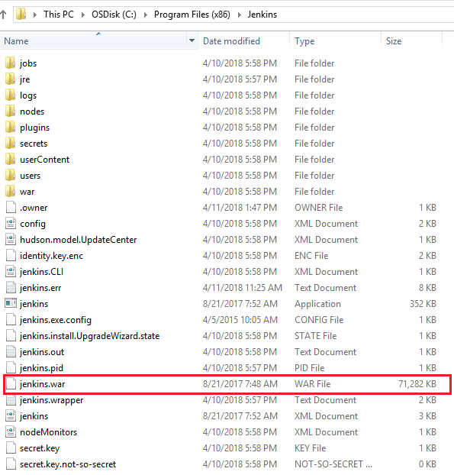
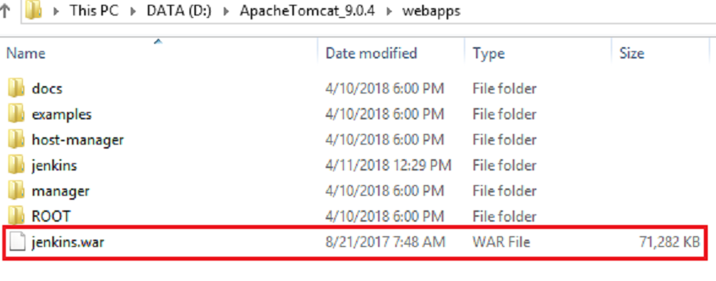
Steps to run Jenkins using Apache Tomcat

Slide 10
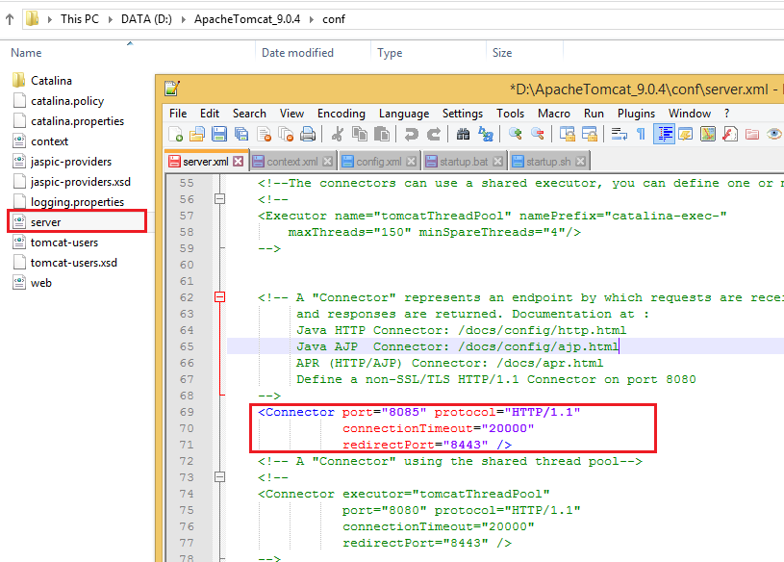
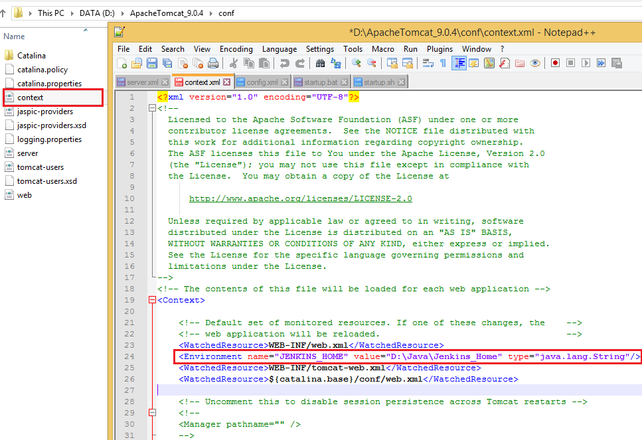

Slide 11
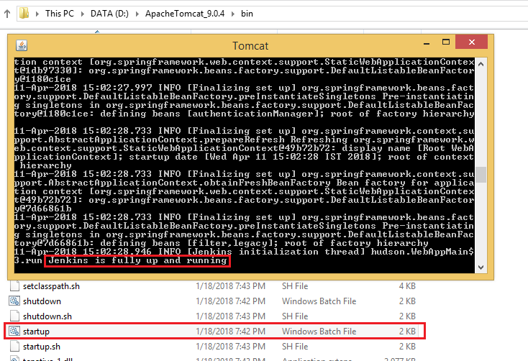

Slide 12
Demo

Slide 13
Thank You !

